Slide 1
AREAL
Advanced Research Electron Accelerator Laboratory
Laser overview
Aghasi Lorsabyan

Slide 2
Content
Introduction
Photocathode and laser beam requirements
Possible layout
How to choose?
Current choice
TODO
Time schedule

Slide 3
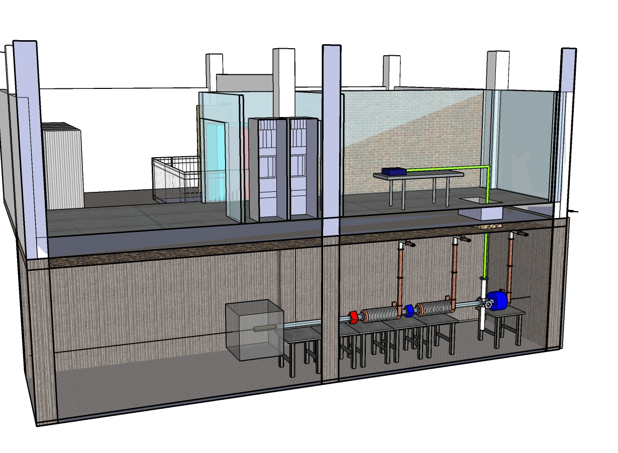
Introduction

Slide 4
Photocathode and laser beam requirements
We will use copper photocathode.
According to AREAL specifications we have following requirements for laser beam.
Parameter | Single bunch | Multi bunch
Laser wavelength (nm) | 253-266 | 253-266
Pump Repetition rate (including relaxation time ) | 1 Hz | ∼81 MHz (harmonic of 3GHz)
Shot Repetition Rate (Hz) | 1 | 1
Beam diameter (mm) | < 5 | < 5
Beam Divergence ( % ) | 0.1% | 0.1%
Pulse duration σ_{z} (ps) | 5-10 | 5-10
Pulse profile transv. / long. | Gaussian / uniform (or Gaussian) | Gaussian / uniform (or Gaussian)
Laser energy per shot (µJ) | 80-100 | 300-400
Energy per pulse (µJ) | 80-100 | > 5
Energy stability (long term) ( %) | ± 1 | ± 1
Pulse-to-pulse jitter (fs) | <100 | <100
Laser power ( W) | < 3 | up to 500

Slide 5
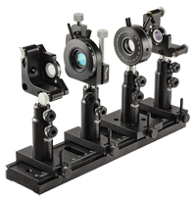
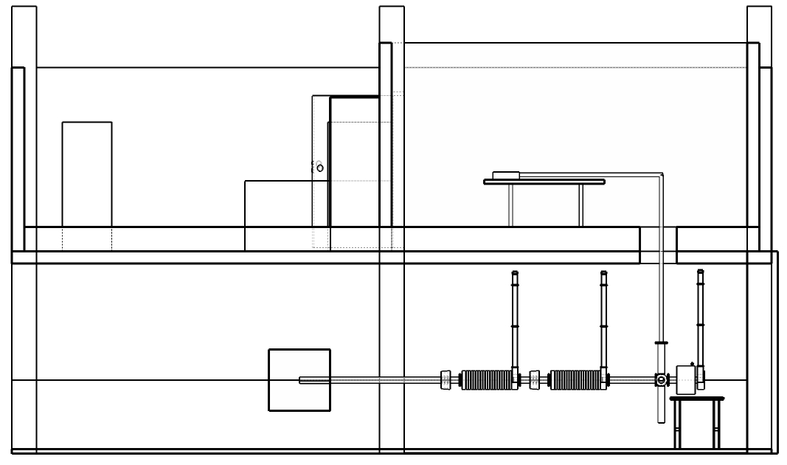
Possible Layout
Scheme is highly depends of laser type
Pump wave (1064 nm)
SHG
SHG
266nm
Pump wave (800 nm)
THG
266nm
Pump wave (266 nm)
266nm
Third Harmonic Generation equipment
Laser
Beam Transportation
Optical Table
Photocathode

Slide 6
How to choose?
Pulse duration
Repetition rate
Price
Power
Wavelength
Minimum requirements
Low price
UV beam or UV harmonic
1-10 ps pulse duration
<100 fs jitter (puls to puls)
Up to 100 MHz PRF
>100 µJ per pulse
Gaussian beam (long. and trans.)

Slide 7
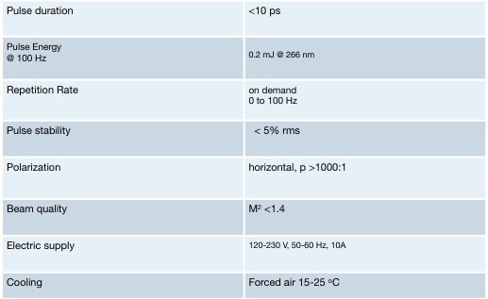
Current choice
Now we are discussing possibilities to use APLQ-100-266 model laser
from ATTODYNE Picosecond Lasers company which have following properties.

Slide 8
TODO
Choose laser (=> optical scheme)
Make simulations
Choose optical elements
Choose diagnostics equipments
Setup laser and optical scheme (table, transportation, alignment, diagnostics, …)
Make synchronization
Try to get electron beam!!!

Slide 9
Time schedule

Slide 10
Thank you for attention!

