Slide 1
Areal RF Station
A. Vardanyan 22.06.2012

Slide 2
RF System
The AREAL RF system will consist of 3 RF stations:
Each RF station has a 1 klystron, and HV modulator, a low-level RF system, preamplifier and an interlock and control system.
1 station required for RF Gun
2 stations for 1m long accelerating sections operation
LLRF systems which controls the amplitude and the phase of the RF
RF power 7 MW in peak at 3 GHz
Interlock and control system.

Slide 3
The required operation parameters
Peak power 6 MW
Gradient 17 MV/m
RF pulse duration 1-2 µs
Repetition rate 1-2 Hz

Slide 4
RF Power Source
Frequency 3 GHz
RF Pulse Duration 1-2 µs
Repetition Rate 1-2 Hz
Cathode Voltage 190 - 200 kV
Beam Current 95 - 105A
HV Pulse Duration 1-2 µs
RF Peak Power 7 MW

Slide 5
K211 Klystron parameters
Output Power peak 7 MW
Efficiency 40 %
Gain (min. dB) 31
Beam voltage 200 KV
Beam peak current 92A

Slide 6
KY211 klystron main parameters
Water and Air Cooling For Operat. Rate (50Hz)
Water flow to body 3.64 l/min min
Water flow to collector 20.5 l/min min
Resistance of cooling water 50 kOhm cm min
Air flow to output window 85 l/min min
Cooling Air pressure 2.1 kg/cm² min

Slide 7
KY211 klystron main parameters
Gain in dB
Peak RF Output Power in MW
Peak RF Input Power in kW

Slide 8
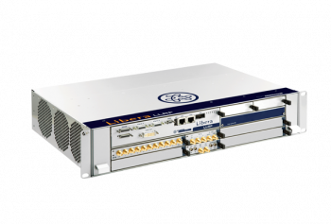
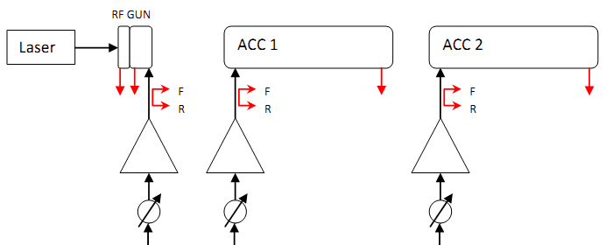
Low level radio frequency control
Characteristics of Signal/Probes:
Phase stability 0.1 deg@3GHz
Amplitude stability 0.1%
Amplitude dynamic range 30 dB
Ready to be integrated into the EPICS control system
The LLRF system ordered by I-Tech LIBERA.

Slide 9
RF control System
Requirements for the RF control system
Phase and amplitude stability of the accelerating field during 2 µs flat-top RF pulse.
field amplitude control 0.1%
Phase control 0.1°
A frequency and phase stable master oscillator for RF reference signals to measure the cavity fields.
The RF control system will provide
remote control for all RF components,
to enable the change of the necessary parameters such as waveguide tuners, phase shifters, etc.

Slide 10
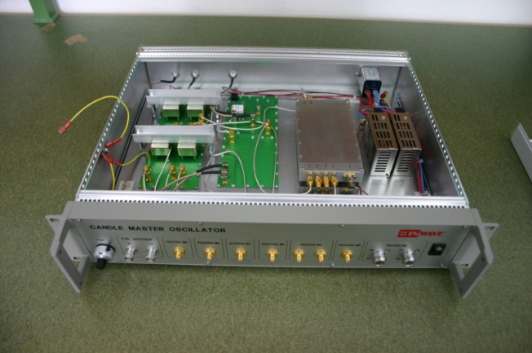
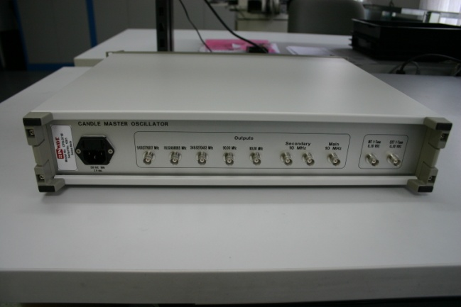
Master Oscillator
The Master oscillator designed by InWave AG according to our requirements.
Frequency ports:
1x 1Hz 1x 9MHz
1x 2Hz 1x 81MHz
1x 9MHz 1x 250MHz
1x 81MHz 2x 90MHz
1x 125MHz 2x 10MHz (Secondary)
1x 250MHz 1x 10MHz (main)
2x 500MHz
1x 1GHz
2x 3GHz

Slide 11
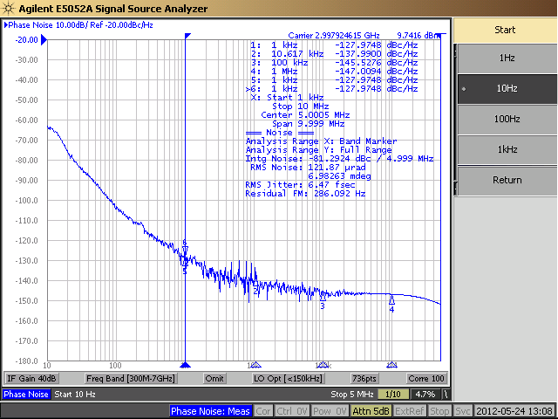
The measurement results
The picture describes RMS phase Jitter 6.47 fsec !

Slide 12
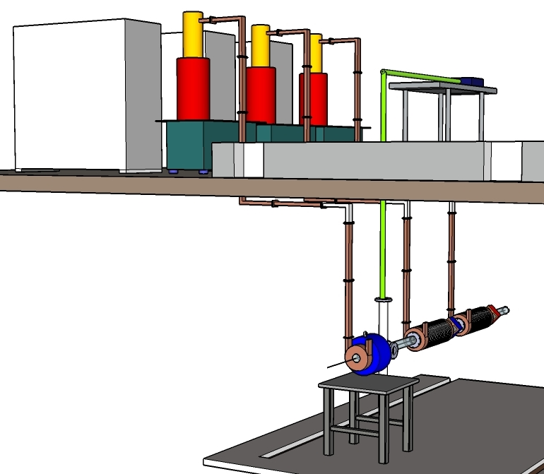
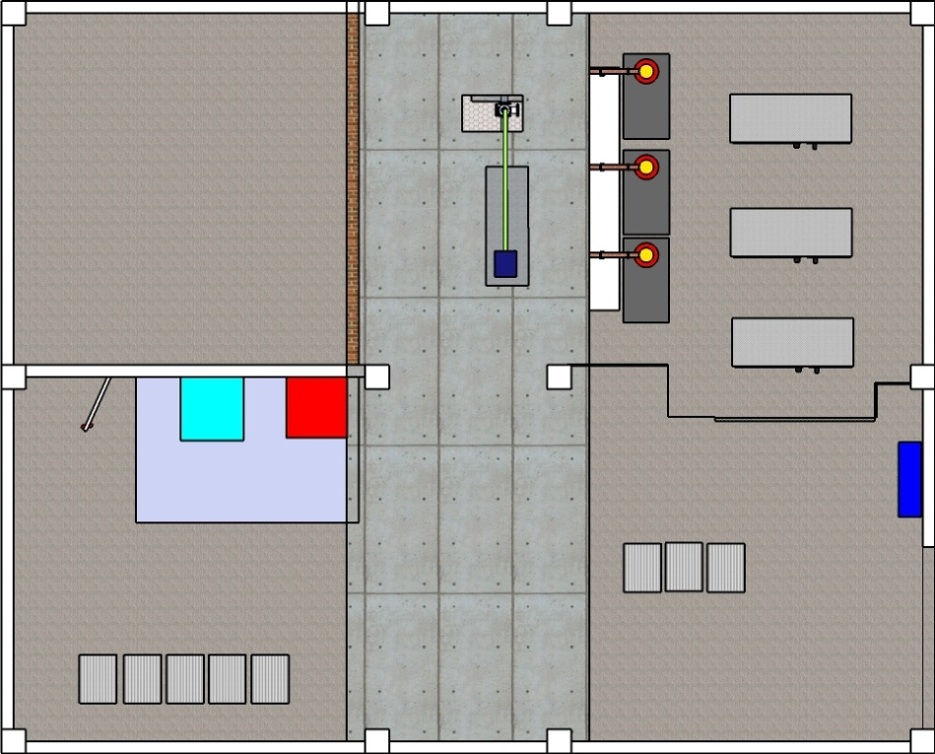
Location of RF equipment in AREAL building

Slide 13
RF Test stand
Modulator (HV pulse power source)
HV pulse modulator
1:18,2 pulse transformer in an oil tank.
The nominal pulse duration is 2 µs.
Requirements to the flat top ripple
should not exceed ±1%.
The pulse-to-pulse stability better than ±0.5%.

Slide 14
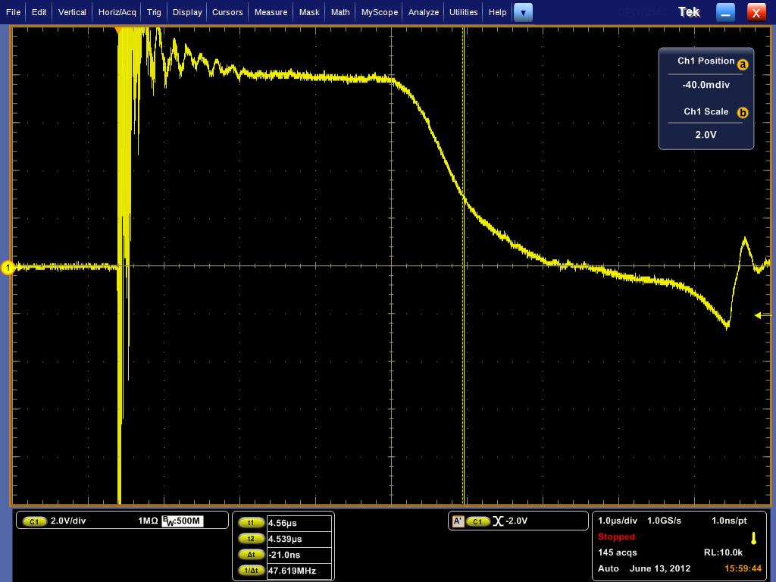
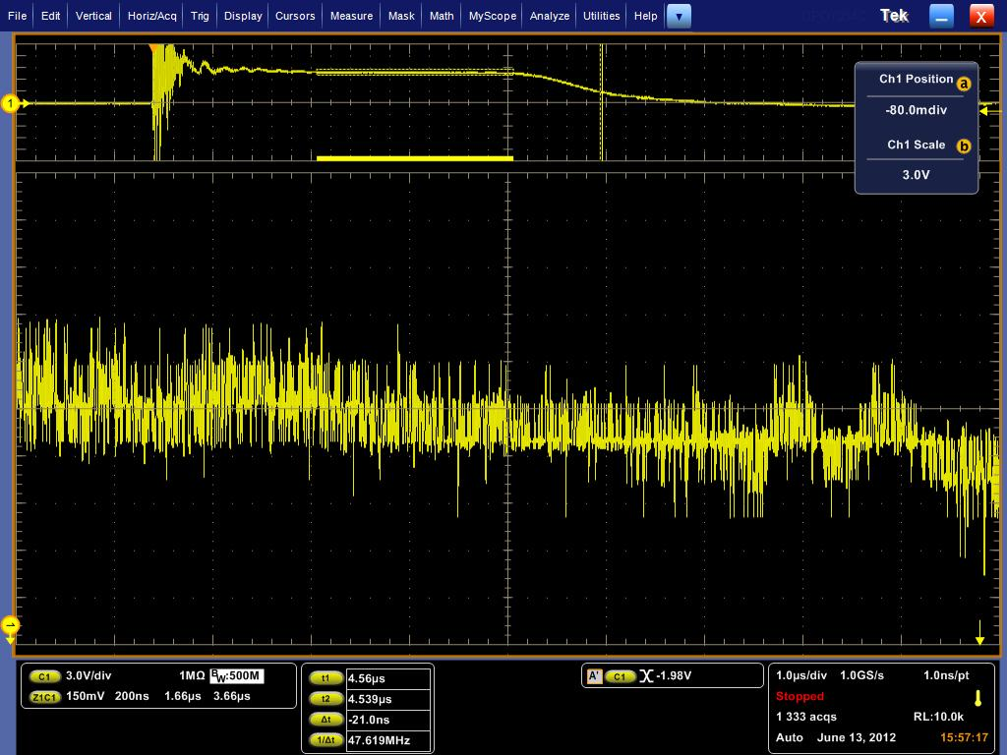
RF Test stand
Modulator Measurements
Amplitude flatnes ~ 1.2%

Slide 15
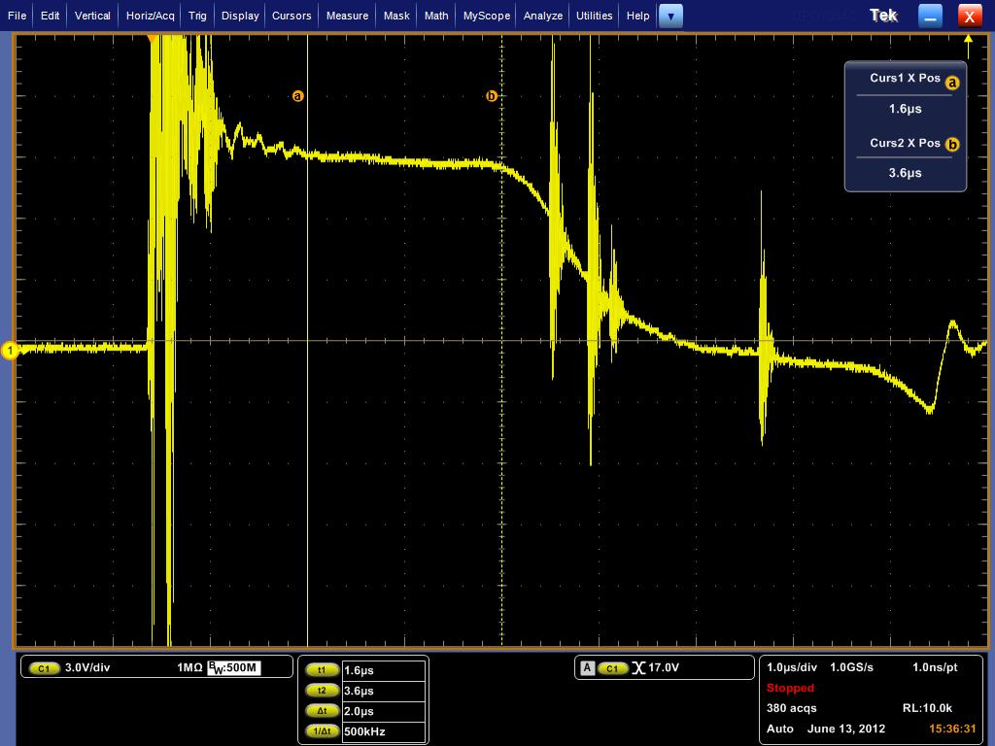
> 200 kV
RF Test stand
Modulator Measurements

Slide 16
RF Test stand
The wave impedance of the cable must match the impedance of the klystron transformers primary side to avoid distortion of the pulse shape. To achieve that it is supposed to use 7 cables in parallel, each of 18 mm2 cross section, 37Ω impedance, and an outer diameter of 20 mm.
4 power supplies are required to enable the operation of the klystron and the modulator, the klystron focusing solenoid, the klystron filament, vacuum pump and the Interlock.
The interlock system protects the accelerator and the RF stations. Besides the modulator interlock system, an additional digital interlock system for the RF system is required.
It will be based on programmable logic devices which can be easily modified upon necessity.
The Digital Interlock System will be implemented after the LINAC first stage completion.

