Slide 1


AREAL Linear Accelerator cooling system design.
Vardanyan Vahagn

Slide 2
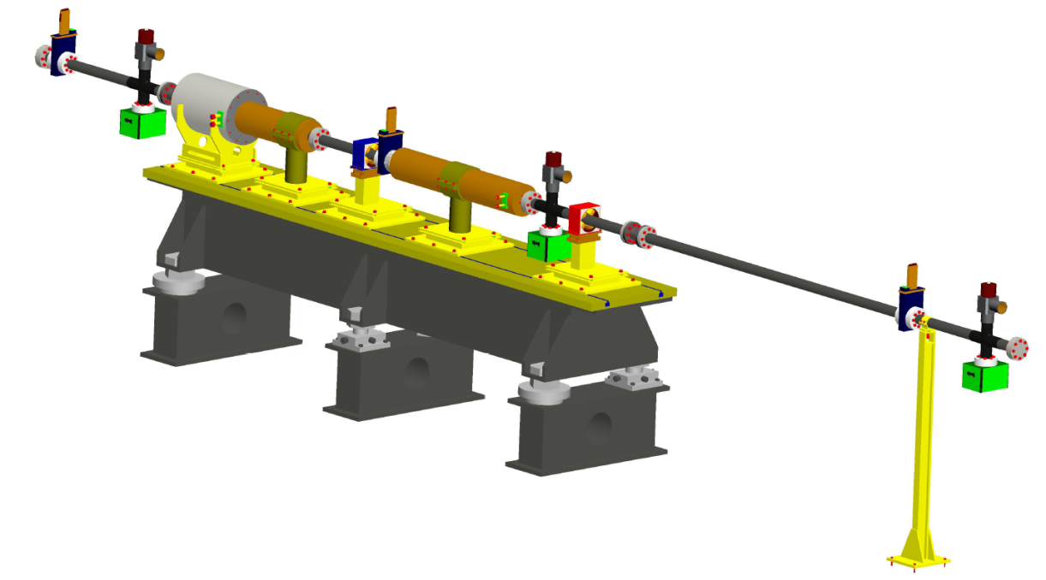
AREAL Linear Accelerator Cooling system's Specification.
Significance.
Linear accelerator consists of various types of equipment. During operation of the accelerator, many of these equipment produce large amounts of heat. For the normal operation of the Linear Accelerator required to remove heat. Heat removal from the system can be performed using different cooling systems.
For selected accelerator cooling system should be taken into account accelerator equipment specifications.

Slide 3
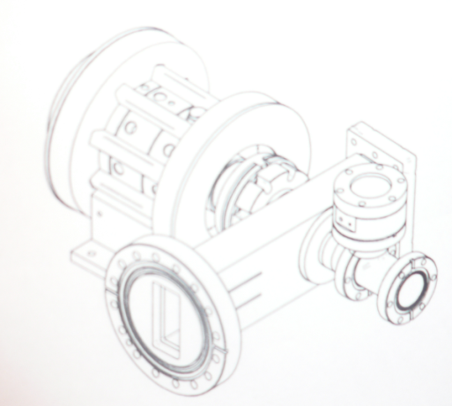
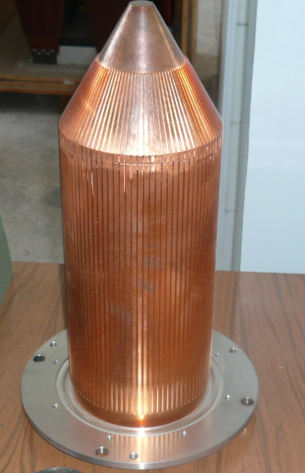
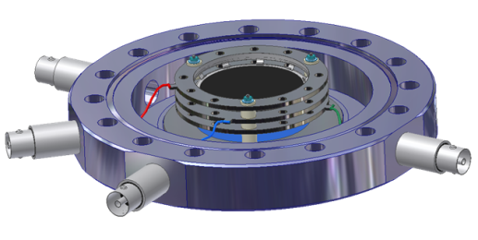
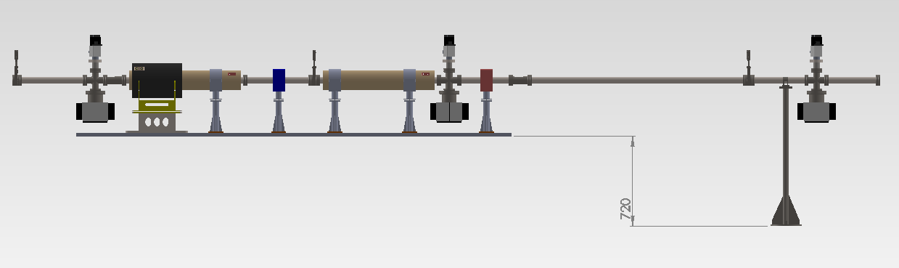
GUN
Beam dumps
Quadruple Magnets
S-Band
accel. sections

Slide 4
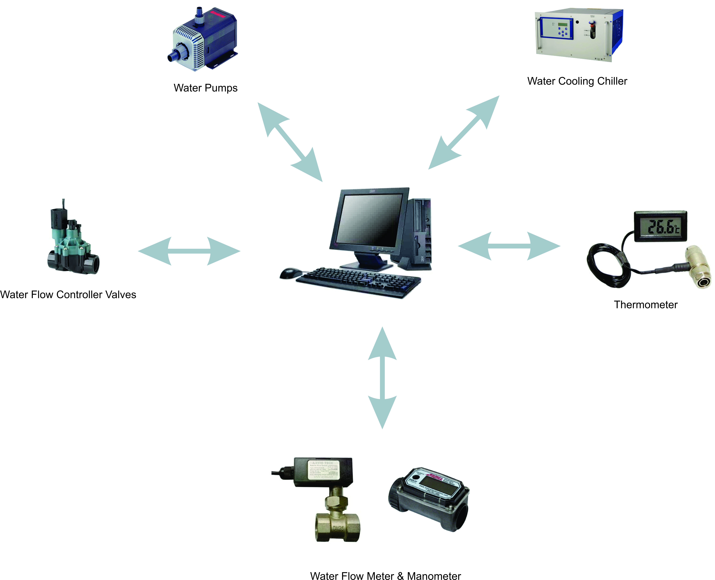
Basic requirements for the cooling system.
General requirements.
1. High productivity.
2. Economic efficiency.
3. Safety.
4. High Automation.
5. Easy maintenance.
Parameters.
Parameters of the equipment cooling system.
Equipment Quantity.
Features of the building.

Slide 5
AREAL Cooling System features.
 | Gun | Klystron | Beam Dumps, Magnet | RF cavity
Cooling capacity (W) | 1600 | 150 | 150 | 14
Temperature (⁰C) | 42.5 | 42.5 | 30 | 30
Temperature Stability (⁰C) | +/-0.1 | +/-0.1 | +/-1 | +/-0.1
Water Flow rate (l/min) | 22 | 3.6 | 3.6 | 22
Pressure | Not exceed 4.2kg/cm²

Slide 6
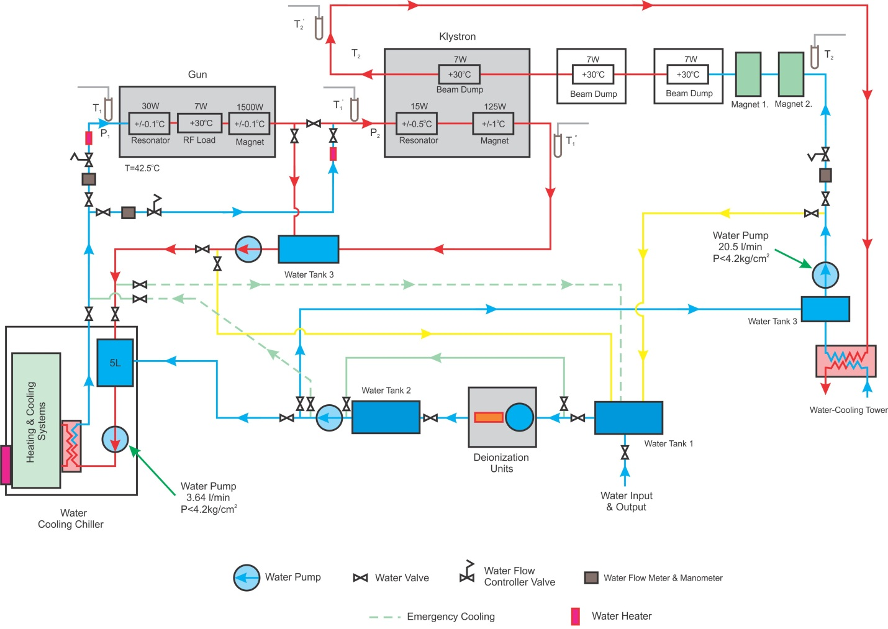

Slide 7
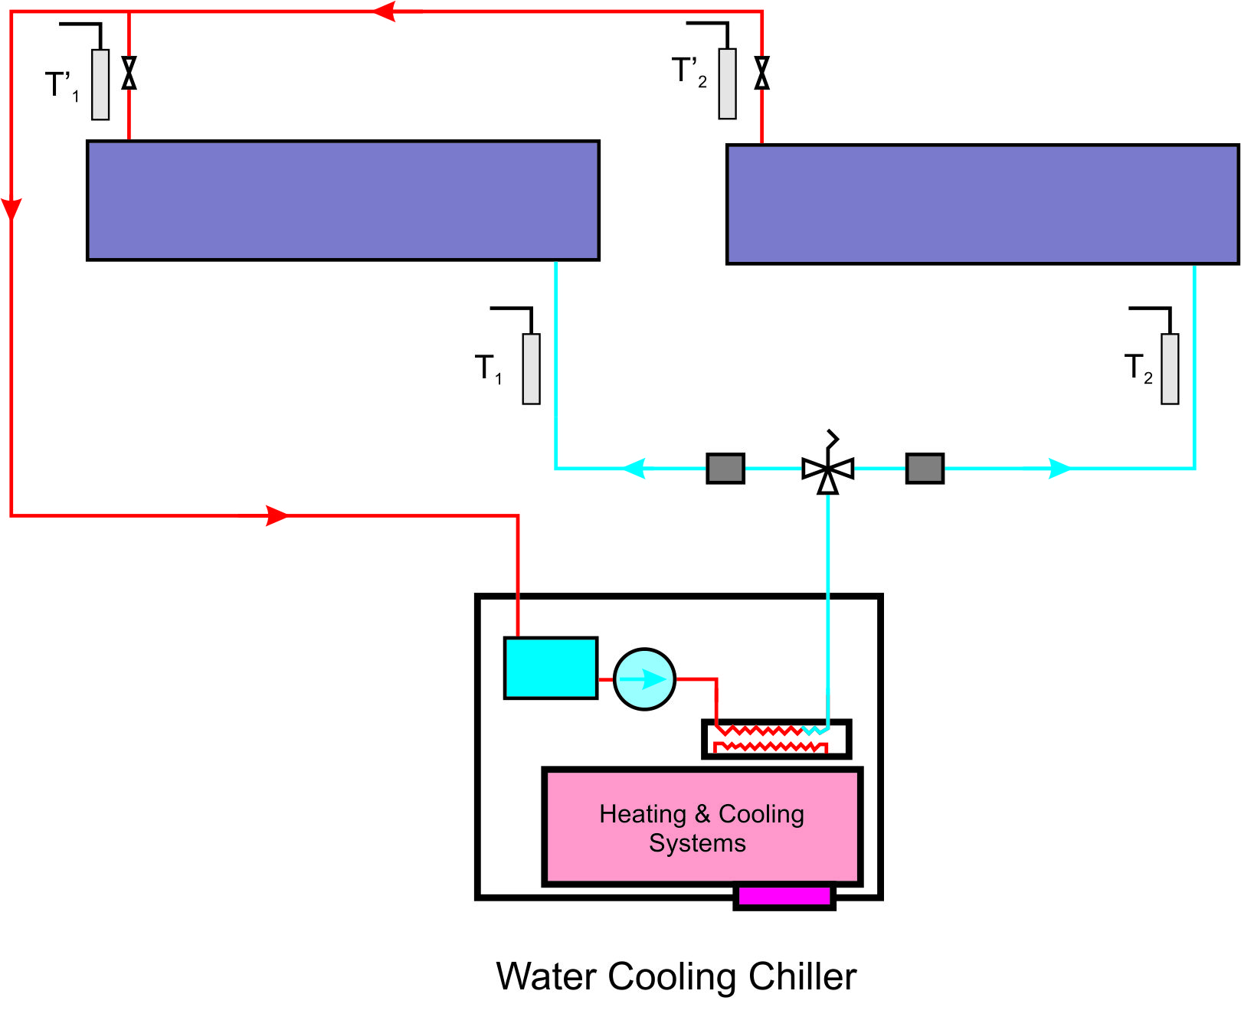
Accel. Sec. 1.
Accel. Sec. 2.

Slide 8
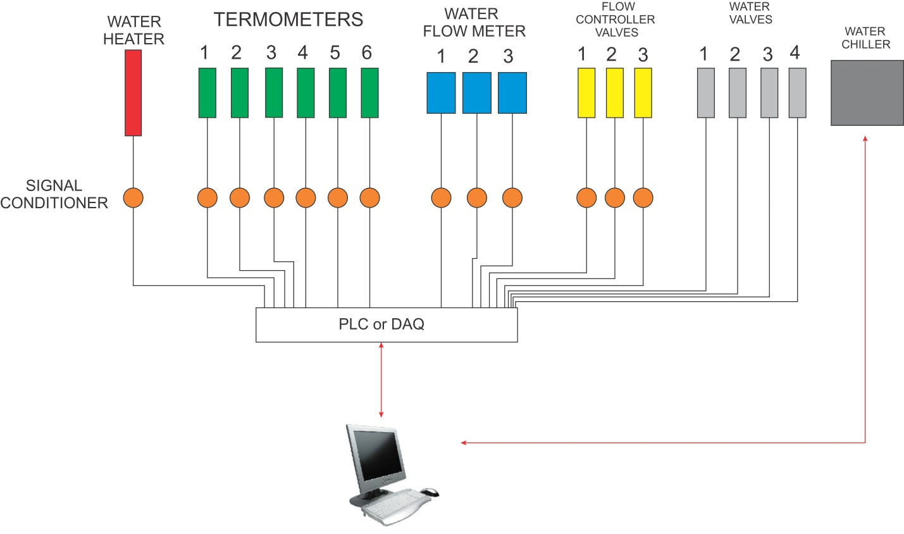
Automation of the cooling system.

Slide 9

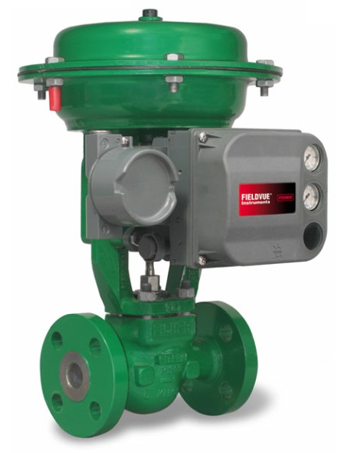
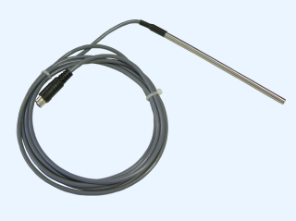
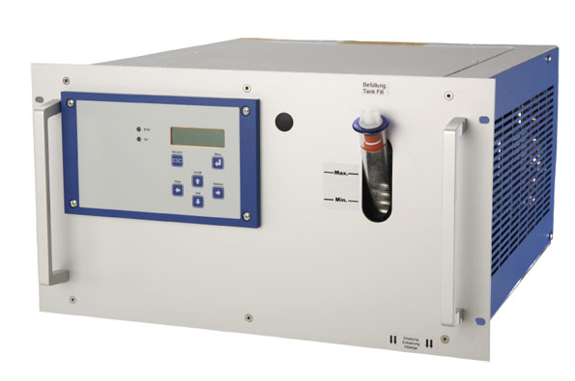
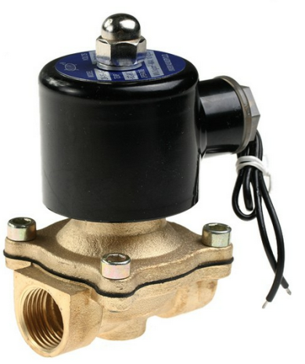
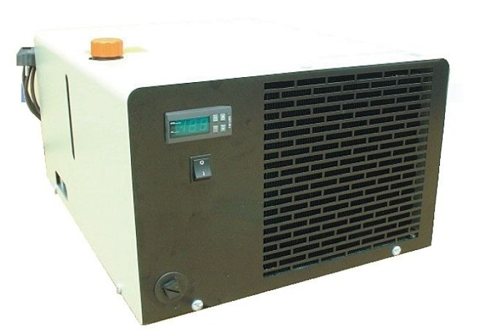
Temperature Sensors
flow controller
Water de-ionizer
Water Chillers
Electric Valves

Slide 10
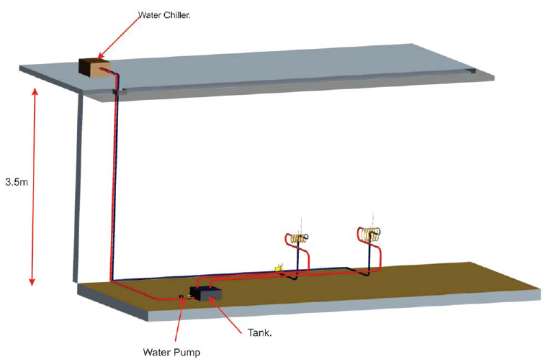
AREAL Cooling System 3D Model.

Slide 11
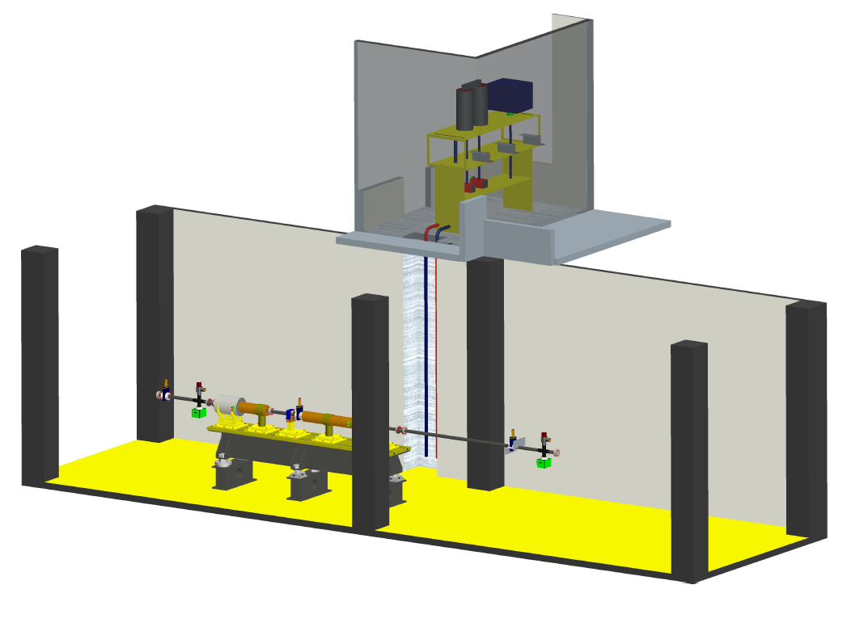
Cooling Equipment Room
6 m²

Slide 12
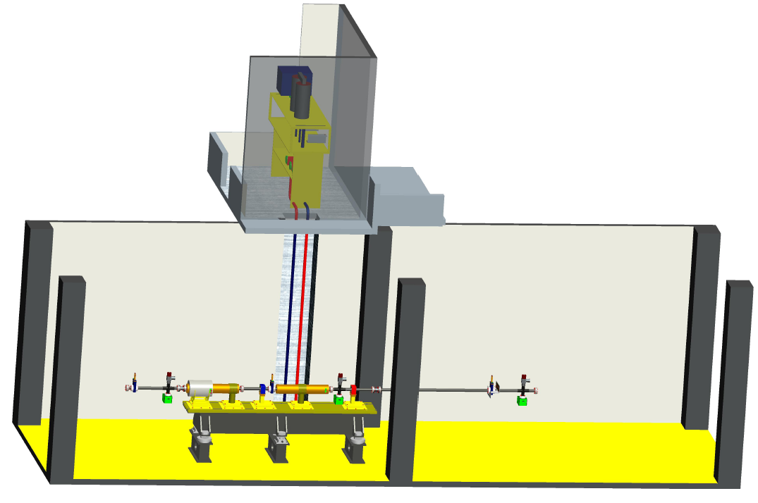
Water Chillers
Water de-ionizer
Frozen Water.
Heated Water

Slide 13
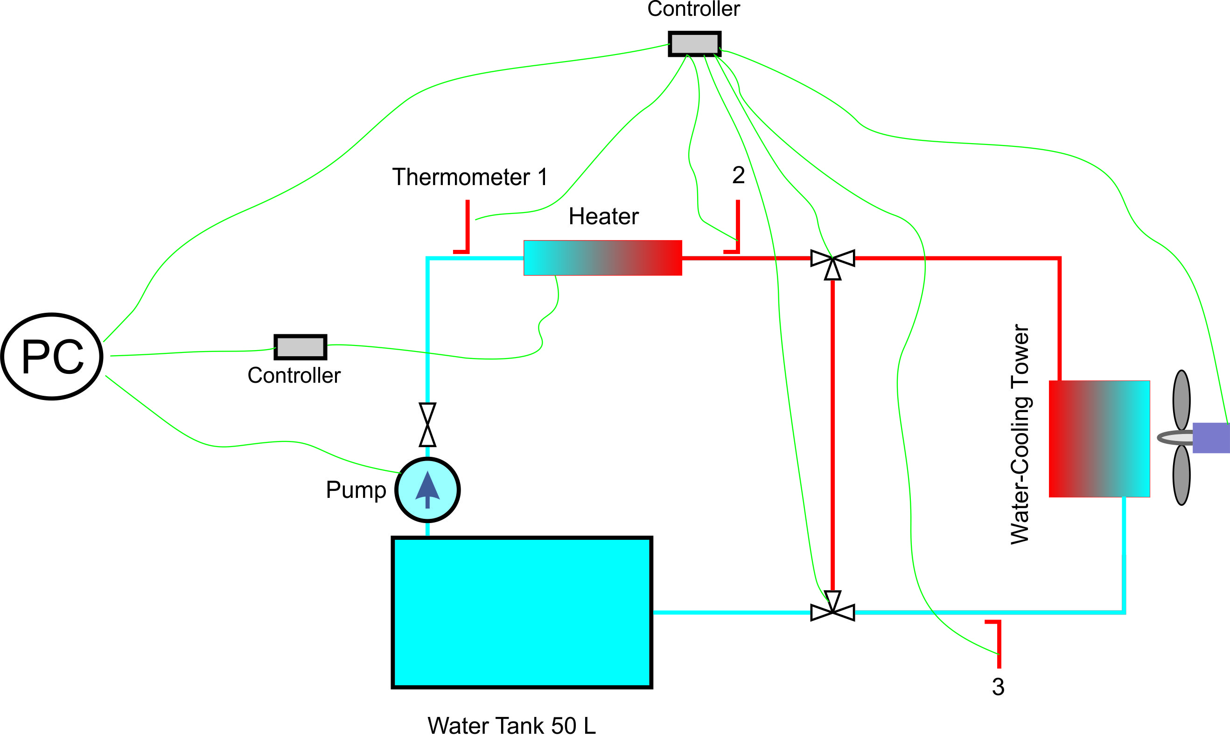
Test Bench Scheme.

Slide 14




Software

Slide 15
Thanks for listening.

