Slide 1
Advanced Research Electron Accelerator Laboratory
Linear Accelerator Layout and Progress
B. Grigoryan

Slide 2
Contents
Linear Accelerator Layout
Building and Infrastructure
RF Gun
Laser System
RF System
Cooling System
Vacuum System
Control System and Diagnostics
Time Schedule

Slide 3
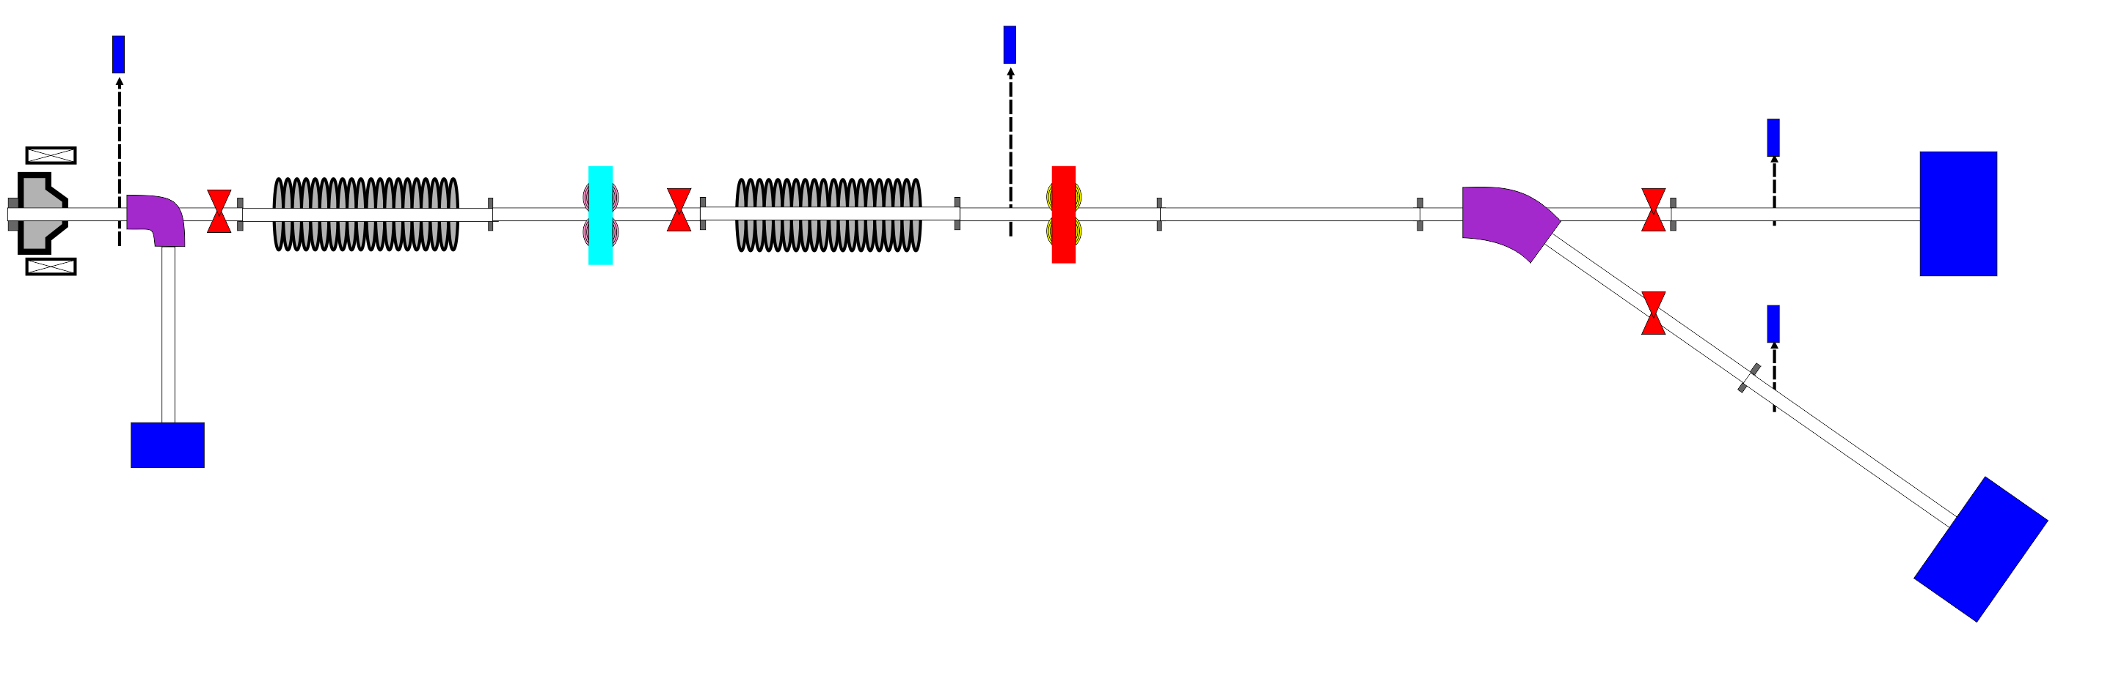
Linear Accelerator Layout
Gun Diagnostics + Experiments
Diagnostics
+
Experiments
Diagnostics
+
Experiments
3-5 MeV
12 MeV max. 22 MeV
20 MeV max. 45 MeV
Machine length up to beam dump ~9m. Tunnel length 12m with farther ~3m extension possibility
Bunch charge | 200 pC
Peak current at cathode | ~ 20 A
Bunch transverse rms size | ~ 800 um
Normalized transverse emittance | < 0.5 mm-mrad
FWHM bunch length | 5 -10 ps
Beam energy | 20 MeV
Rms energy spread | < 20 keV

Slide 4
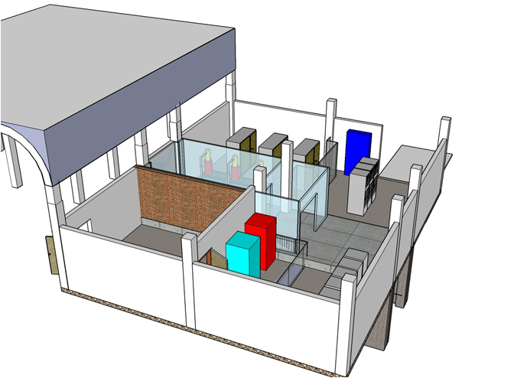
Building & Infrastructure

Slide 5
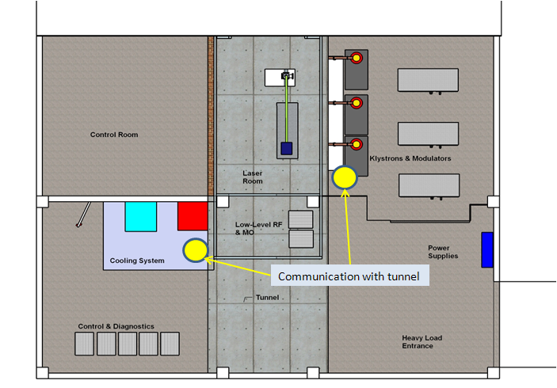
Building & Infrastructure

Slide 6
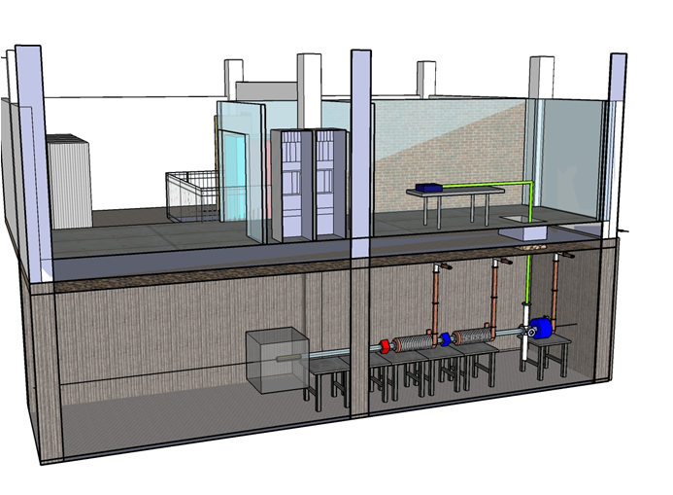
Building & Infrastructure

Slide 7
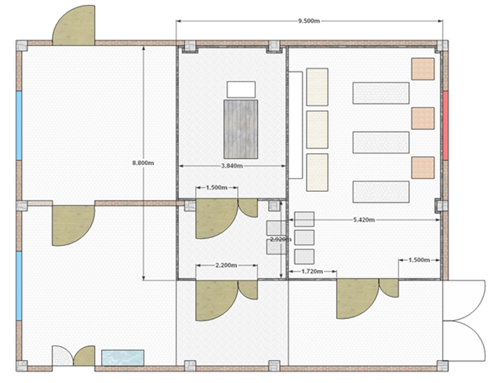
Building & Infrastructure

Slide 8
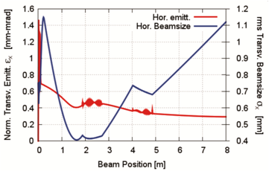
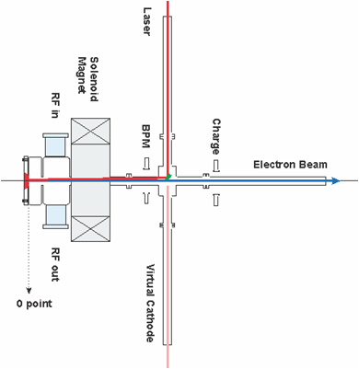
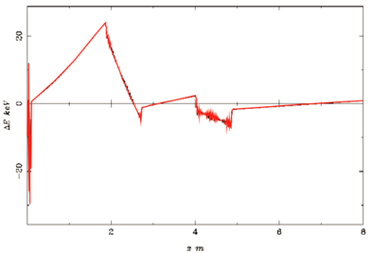
RF Gun
1.6 cell PSI type gun and solenoid scaled respectively
Presented at IPAC’11. ”Beam phase space study for AREAL photogun linac”. TUPC032

Slide 9
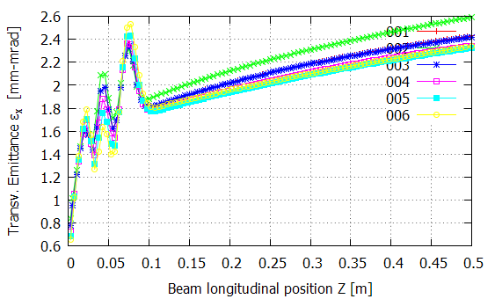
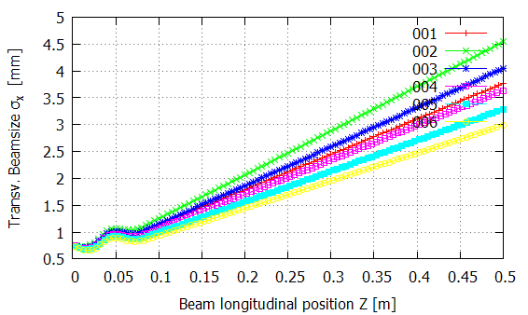
RF Gun
1.5 cell REGAE gun with REGAE solenoid with larger aperture.

Slide 10
RF Gun
1.5 cell REGAE gun with REGAE solenoid with larger aperture.
Study parameters
Gun maximum gradient could be obtained with 7 MW klystron
Possible solutions of solenoid location to compensate space charge effect
Optimize beam parameters for emittance compensation scheme
Space for gun diagnostics
Start-to-end simulations. Goal: minimum emittance laminar flow, minimum energy spread.
Studies are in progress

Slide 11
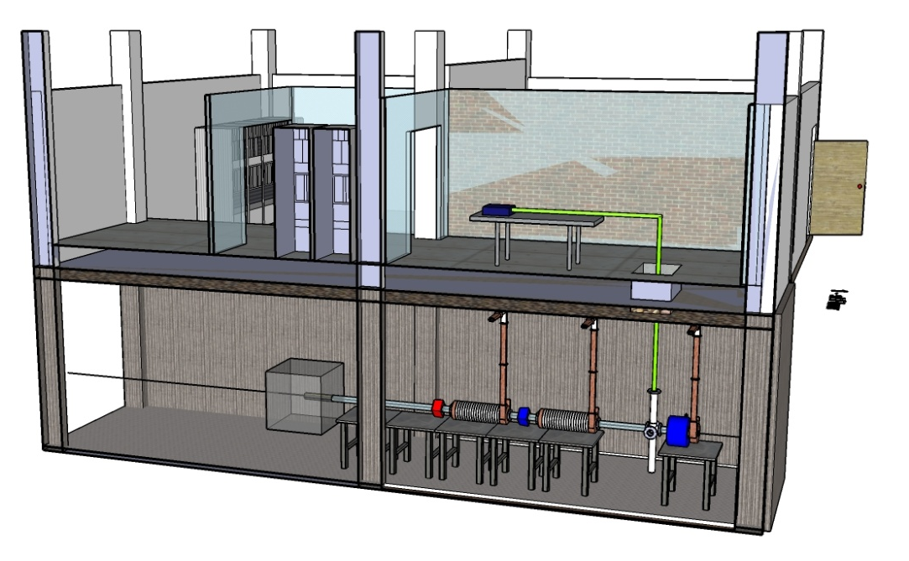
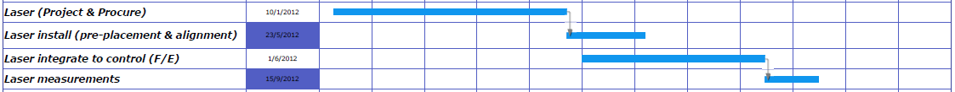
Laser System
Laser setup study is in progress will be finished in July
Parameter | Single bunch
Laser wavelength (nm) | 253-266
Pulse Repetition Rate (Hz) | 1
Shot Repetition Rate (Hz) | 1
Beam diameter (mm) | ~ 5
Beam Divergence ( % ) | 0.1%
Pulse duration σ_{z} (ps) | 5-10
Pulse profile transv. / long. | Gaussian / uniform (or Gaussian)
Energy per pulse (µJ) | 80-100
Energy stability (long term) ( %) | ± 1
Pulse-to-pulse jitter (fs) | <100
Laser power * ( W) | < 3
Market study and discussion for procurement of laser system are in progress

Slide 12
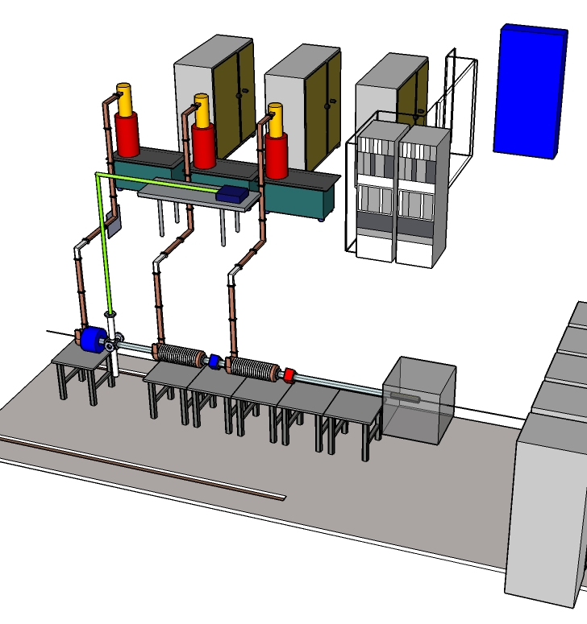
RF System
Main RF frequency | 2997.9246 MHz
Pulse length | 1-2 us
Repetition Rate | 1 Hz
Peak power per pulse | 7 MW
Amplitude stability | < 0.1 %
Phase stability | 0.1º
Number of RF stations | 3
1 commercial LLRF will be used for gun
1 will be customized for 2 ACC sections

Slide 13
Cooling System
Station 1
Electron Gun
RF Station
Station 2
Accelerating section 1
Quadrupoles
Station 3
Accelerating Section 2
RF station
Solenoids
Dump
Load
RF station
Loads
Beam Dumps
Loads
Test stand for Gun and RF station in progress.
Will be ready by the end of July

Slide 14
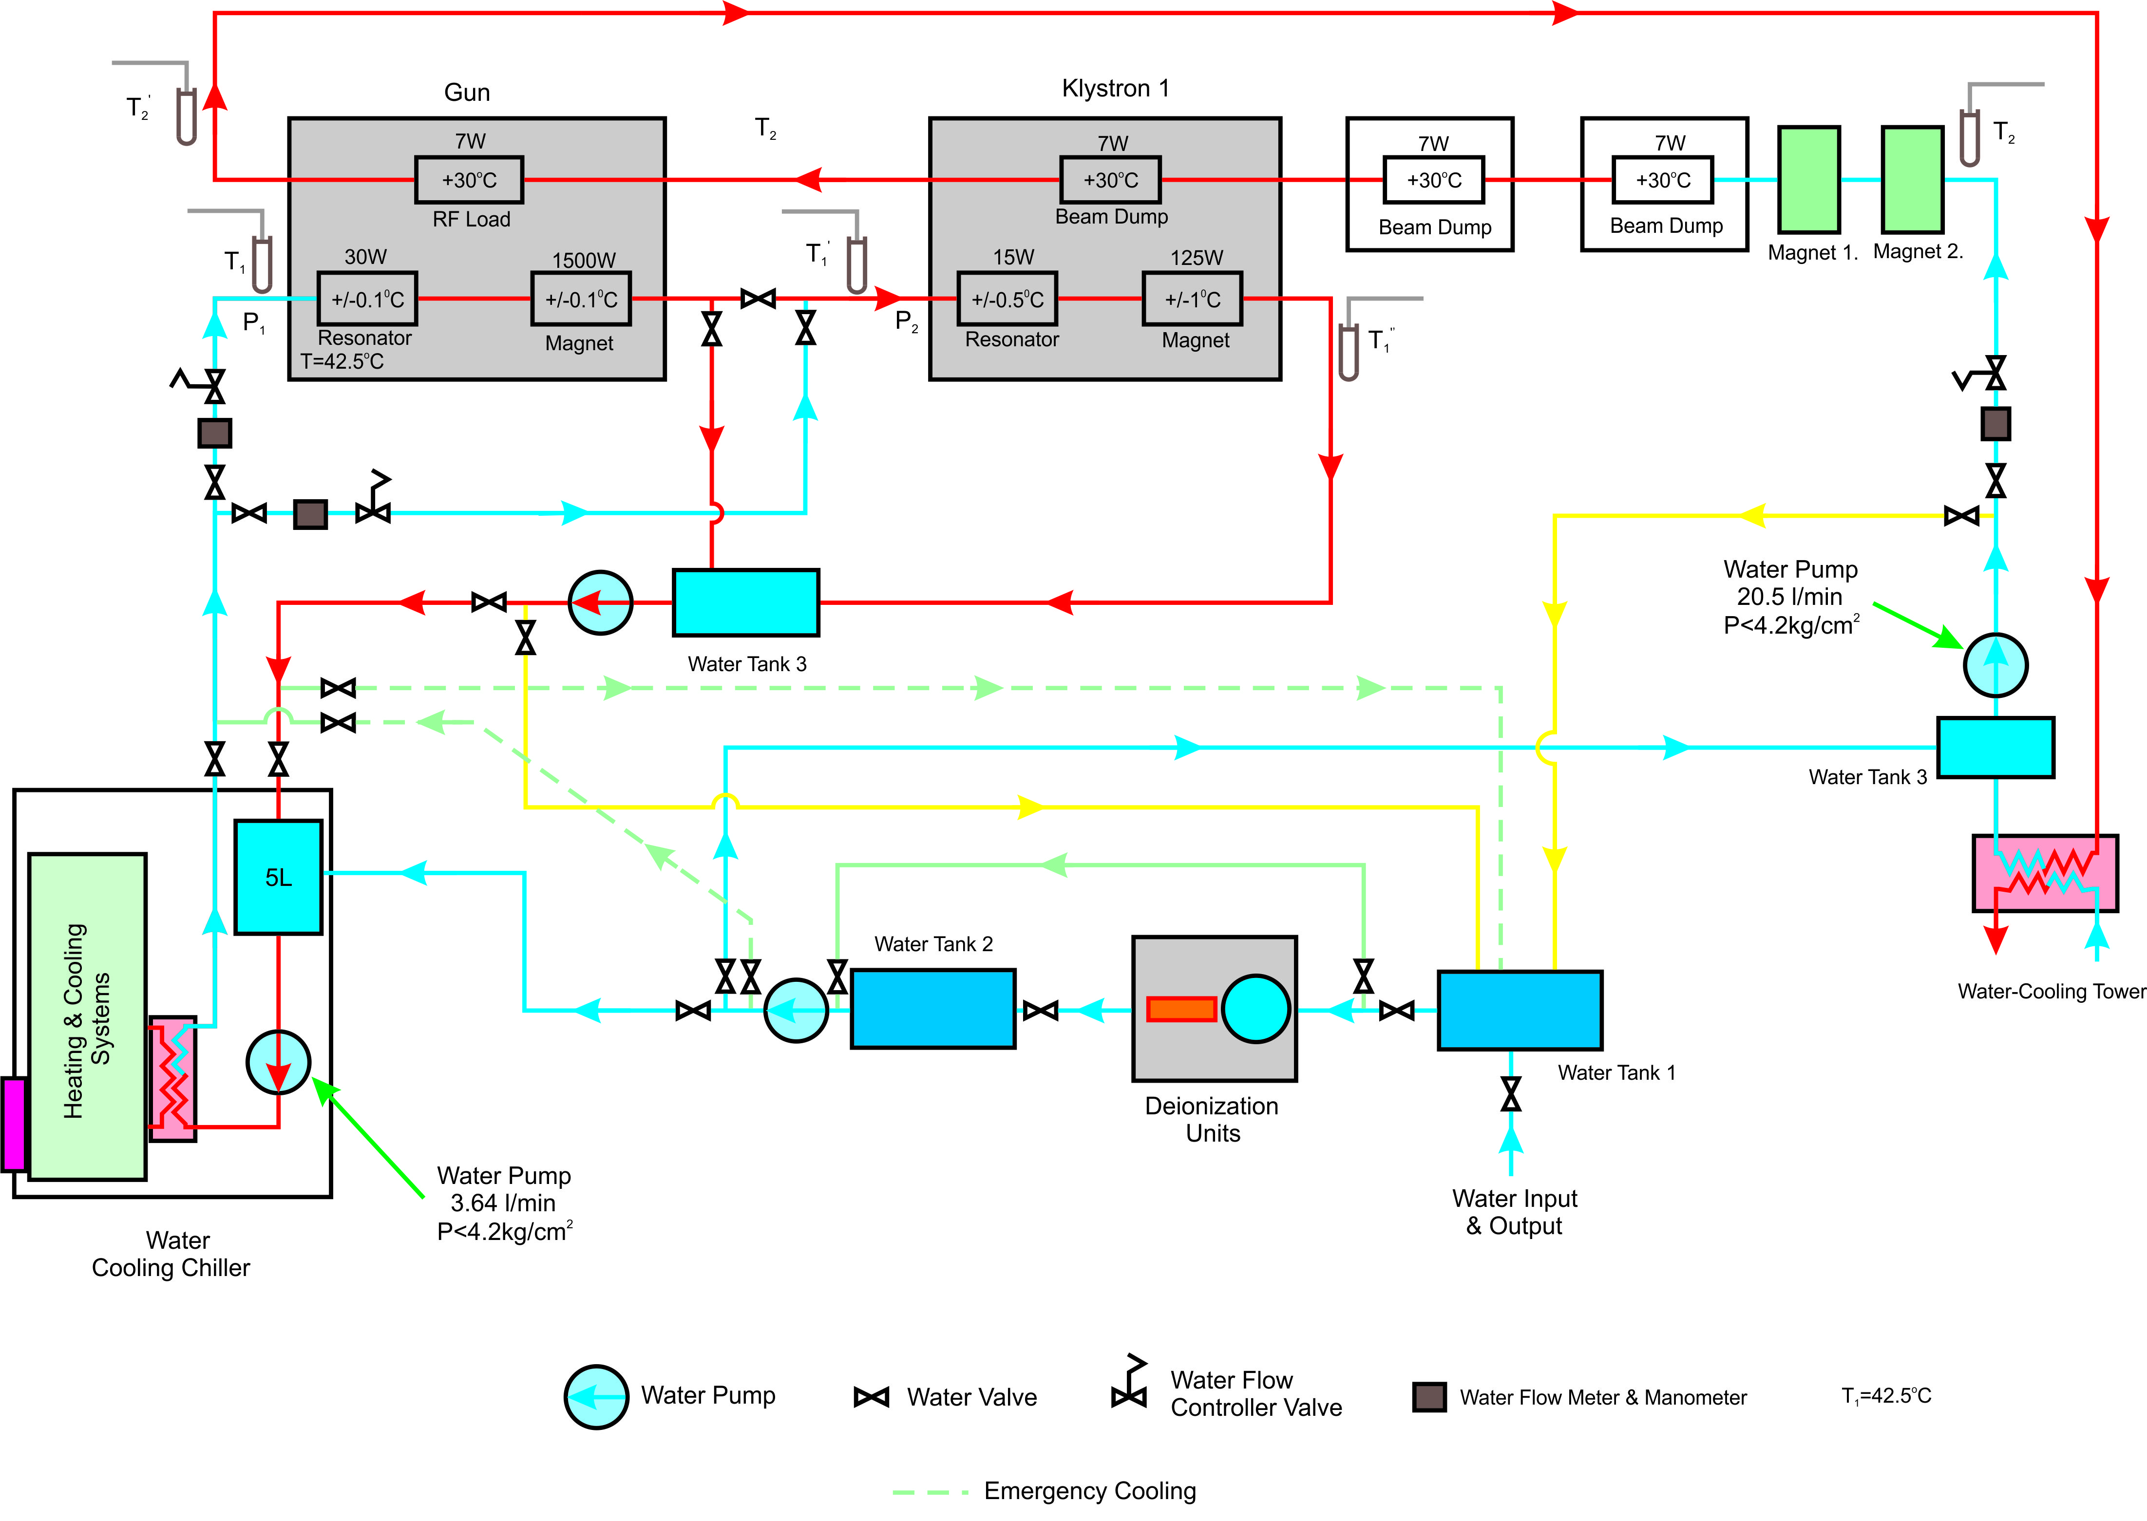
Cooling System
Calculations are finished. Proceeding with test stand procurement and assembly.

Slide 15
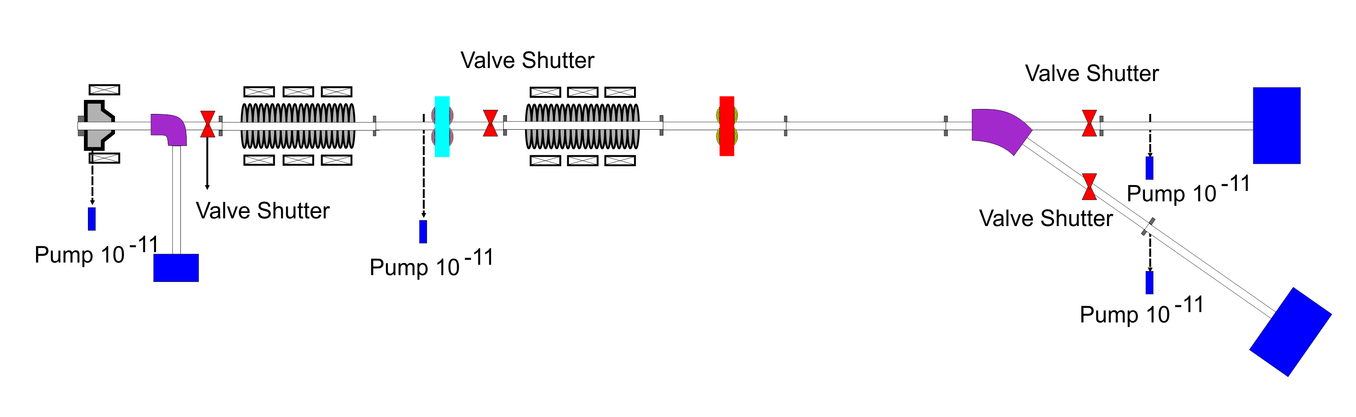
Vacuum System
Nominal vacuum level 10⁻⁹
Flange type standard CF45
Shutters 4
Ion Pumps 4
Number of individ. sections 4
Several components procured. Already at vacuum laboratory
Test stand assembly for vacuum system is in progress
Test and measurement devices required !

Slide 16
Control System and Diagnostics
EPICS platform
Machine Protection
Easy diagnostics integration
Personnel Safety
Fast, Reproducible, Reliable
Components procurement in progress
Development of local subsystems for test stands
Global control system development

Slide 17
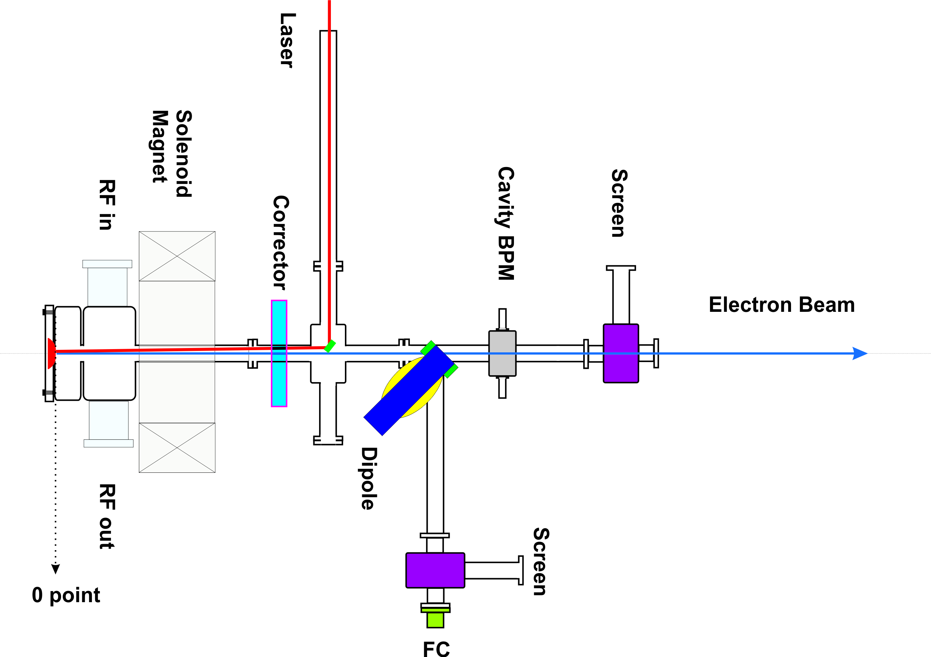
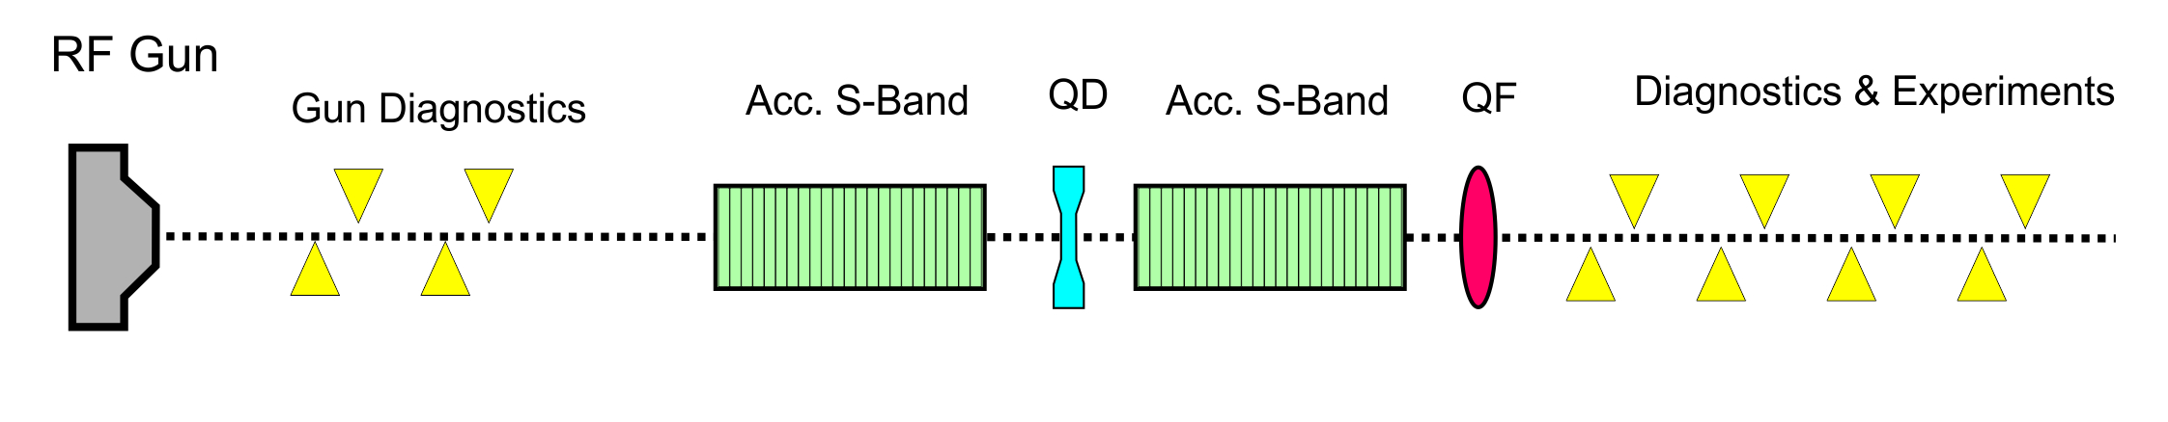
Control System and Diagnostics
Minimal Setup for Gun Diagnostics.

Slide 18
Control System and Diagnostics
Minimal Setup for Gun Diagnostics.
PSI type gun
Calculations and setup in progress

Slide 19
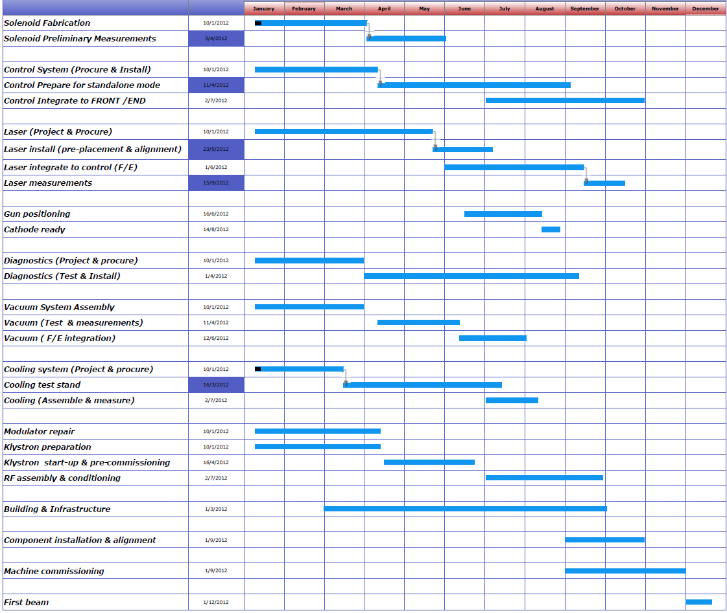
Time Schedule. Phase 1
TAC Meeting
Magnets & girders
Control System
Jan
Febr
March
April
May
June
July
Aug
Sept
Oct
Nov
Dec
Laser System
RF Gun
Jan
Febr
March
April
May
June
July
Aug
Sept
Oct
Nov
Dec
Diagnostics
Vacuum System
Jan
Febr
March
April
May
June
July
Aug
Sept
Oct
Nov
Dec
Cooling System
Jan
Febr
March
April
May
June
July
Aug
Sept
Oct
Nov
Dec
RF System
Jan
Febr
March
April
May
June
July
Aug
Sept
Oct
Nov
Dec
Build. & Infrastructure
Installation
Commissioning

Slide 20
Time Schedule. Progress
Building and Infrastructure
Vacuum test stand
Cooling system test stand
RF laboratory
Laser system setup
Control system setup
Diagnostics
Beam physics studies
Staff wiliness and efforts
International collaborations.
Magnet Fabrication
Girders and alignment technique and technology
Electron gun
Power supplies specifications
RF equipment
Procured equipment delays .

Slide 21
Summary
The construction and infrastructure preparation in progress
Vacuum laboratory and test stand are established .
RF system laboratory established. Proceeding with modulators and klystrons
Laser system setup in progress. We will proceed with procurement process soon.
Control system and diagnostics proceeding in parallel with components setup.
We try to fabricate magnets and girders in Armenia.
We start commissioning next year !!!

